Slide 1
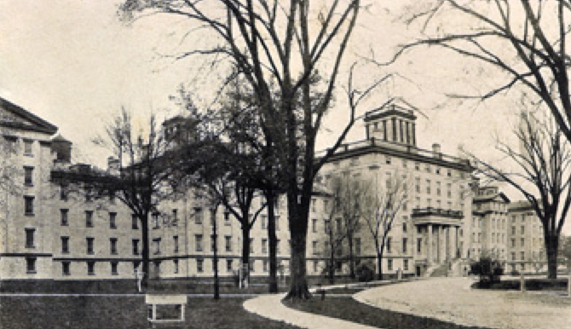
Finding Dirk
http://asylumproject.org
Insanity in the 19th Century
Chicago Genealogical Society
11 September 2023

Slide 2
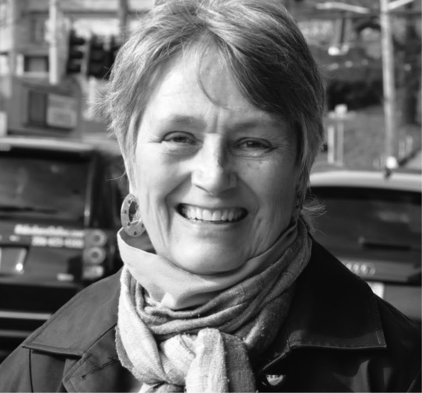
Jill Morelli, cg®
genealogist, educator & writer
http://theCDGseries.wordpress.com

Slide 3
Newspaper headline…
“…jails are not suitable places
for the mentally ill to be warehoused.”

Slide 4
Newspaper headline…
“…jails are not suitable places
for the mentally ill to be warehoused.”
-- U.S. District Judge Marsha Pechman
3 April 2015, Seattle Times

Slide 5
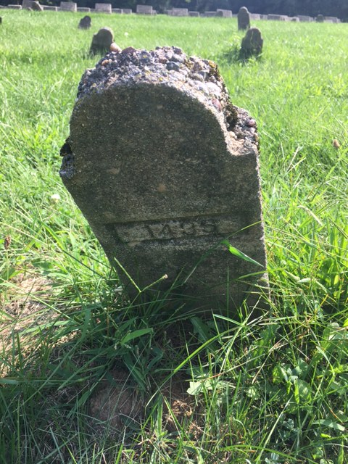
Notes:
#1435

Slide 6
Our session themes…
Understand the genealogical problem
Understand the historical context
Learn what records are available

Slide 7
What’s the Problem?
Access rules and regulations vary widely
  Institutional level
  County level
  State level
  Federal level
HIPAA
“Interpretations” of HIPAA by local authorities
Changing vocabulary over the years
Notes:
HIPAA:

Slide 8
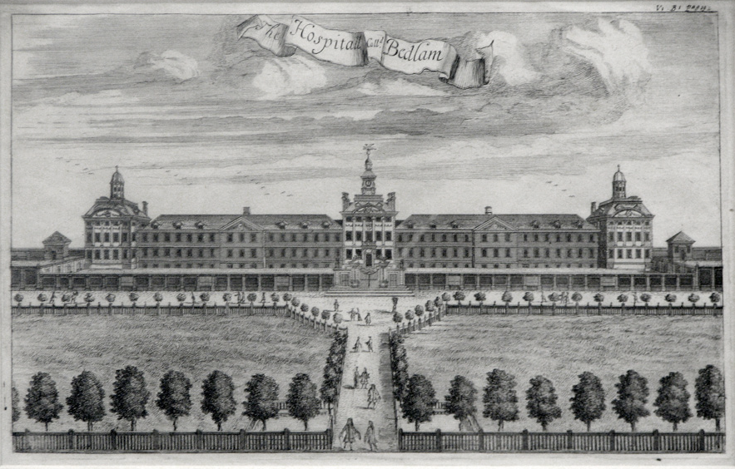
Timeline: Organized Patient Care
Notes:
Bethlem Hospital organized originally in the late 1600’s and run by the Munro family for 125 years.

Slide 9
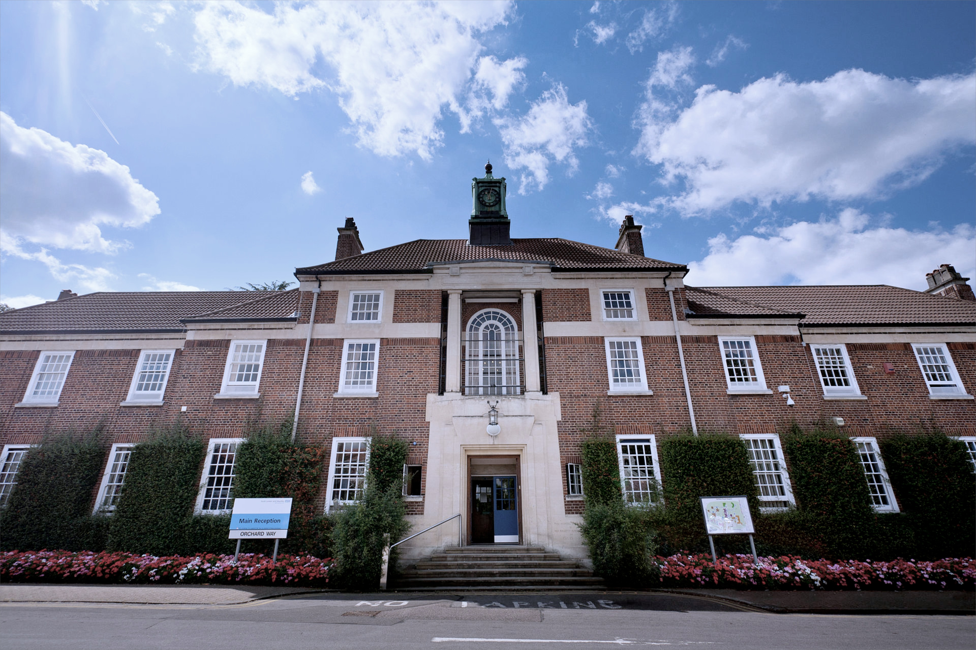
Timeline
1600s
  The Practice of Physik: Two Discourses Concerning the Soul of Brutes
1700s:
  Bleeding, violent purges, near starvation (refocused the brain)
  1774 passage of regulations which allowed courts to “certify” the insane
  Bethlem Royal Hospital & the “madhouse business”
  "Bethlem Royal Hospital Main building view 1" by SLaMNHSFT - Own work. Licensed under CC BY-SA 3.0
Notes:
“Hospital as jail”
King George III: a medical triumph 1789
Sentiment to be set aside
Spectator sport
Dumping grounds for the annoying

Slide 10
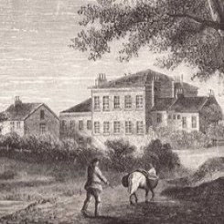
Timeline, continued…
1800s:
  “Moral Treatment”
  The Retreat, York, England
  1817 in US Philadelphia
  Benjamin Rush/Philippe Pinel
  http://www.quakersintheworld.org/quakers-in-action/92
Notes:
Open space, 4 meals a day, glass of wine with snacks. Kept busy with gardening, sewing, and could read, write and play games; “soft speech is to distempered wrath, medicinal” Aeschylus. Treatment?: warm bath set standard for a century.
1800s: preachers shifted from hell and damnation to a welcoming lord—US ready for reform in

Slide 11
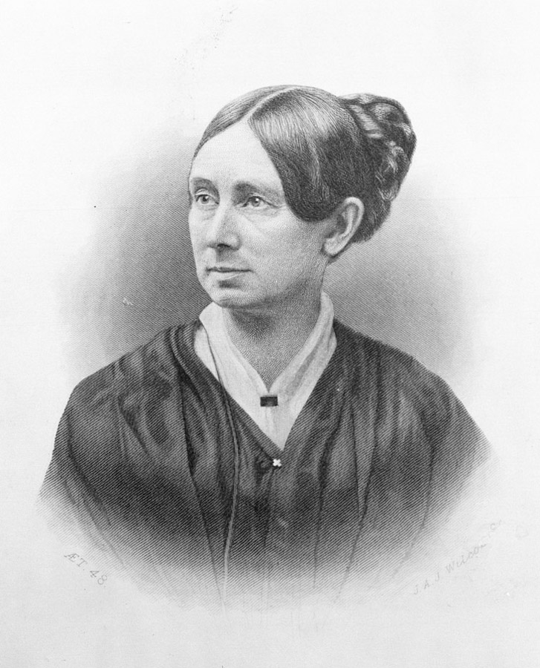
Dorothea Dix
Lobbied the states 1840-1850
Effective: > 20 states built asylums
1840: 2561 patients &
18 hospitals
1890: 74,000 patients
1880: 139 hospitals
Notes:
Could be viewed negatively: she so raised the awareness of the states that they became overwhelmed by the population seeking state assistance. This resulted in too many people and a degradation of the “moral treatment” approach and a backlash to more penal approaches.

Slide 12
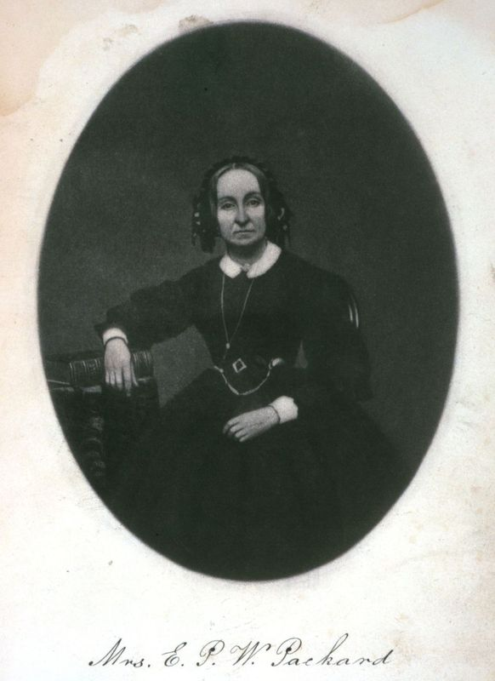
Elizabeth Packard
"I do not call people insane because they differ with me. I pronounce her a sane woman and wish we had a nation of such women.” --Illinois judge, 1863
Notes:
Two ways in the 1860 to be deemed insane and committed to the asylum…..
1816-1897
Jacksonville Insane Asylum, 1860-1863
In 1867, the State of Illinois passed a "Bill for the Protection of Personal Liberty" which guaranteed all people accused of insanity, including wives, had the right to a public hearing. She also saw similar laws passed in three other states.

Slide 13
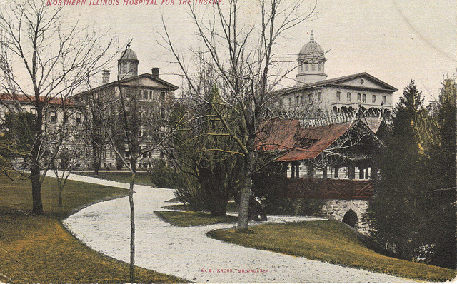
“Kate Lee”
A Year at the Elgin Insane Asylum,
1902.
Notes:
Held at Elgin for one year. Considered sane but committed by the court to the insane asylum. She kept a diary of her year. After one year was released.

Slide 14
David Hiram Smith
“Mother I must tell you ... I feel very sad and the tears run out of my eyes all the time and I don't know why.”
1870 - 1902

Slide 15
“Moral Treatment” Doomed
Doctors desired a medical/medicine answer
States assigned a variety of patients, not just insane—epileptics, syphilitics, alcoholics, senile
Assigned criminally insane
So many patients, hospitals must get larger
Run by Boards more interested in the bottom line
By 1892, superintendents declared “insanity a symptom of disease.” “Moral treatment” was derided as not effective and not addressing the real reasons for insanity. Backlash to the treatment methods of the 1700s.
Notes:
250 was considered correct size for the intimate approach demanded by “moral treatment”; however, so may patients resulted in a need for a larger facility and a more random selection of staff.
Treatment outcomes declined

Slide 16
Finding Dirk
1848-1905

Slide 17
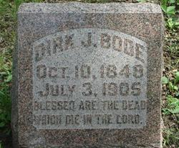
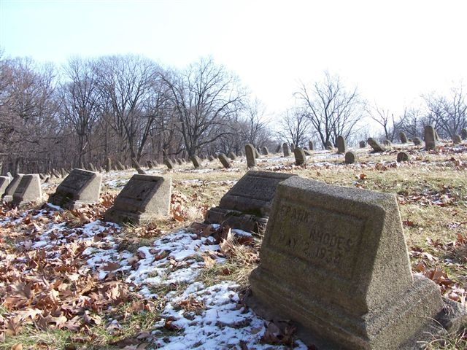
used with permission

Slide 18
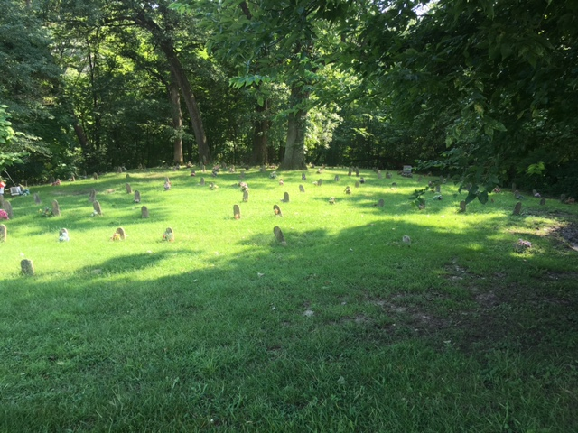

Slide 19
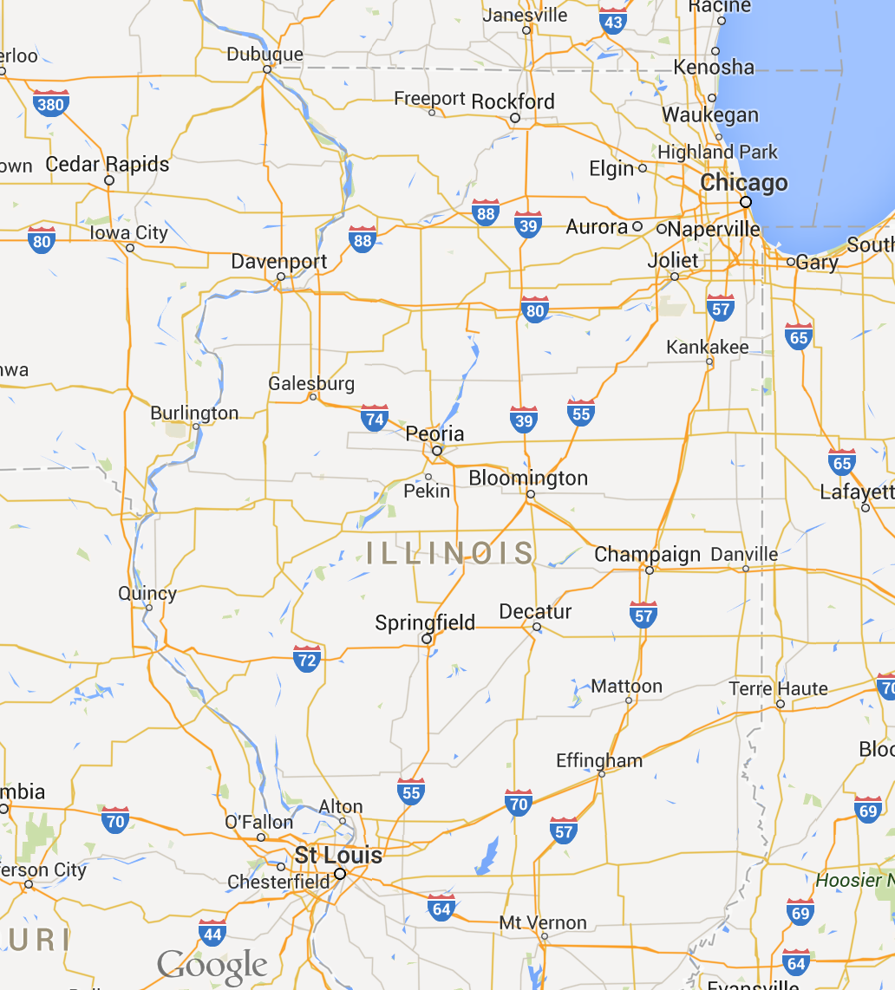

Slide 20
Central Hospital for the Insane
Jacksonville, Illinois

Slide 22
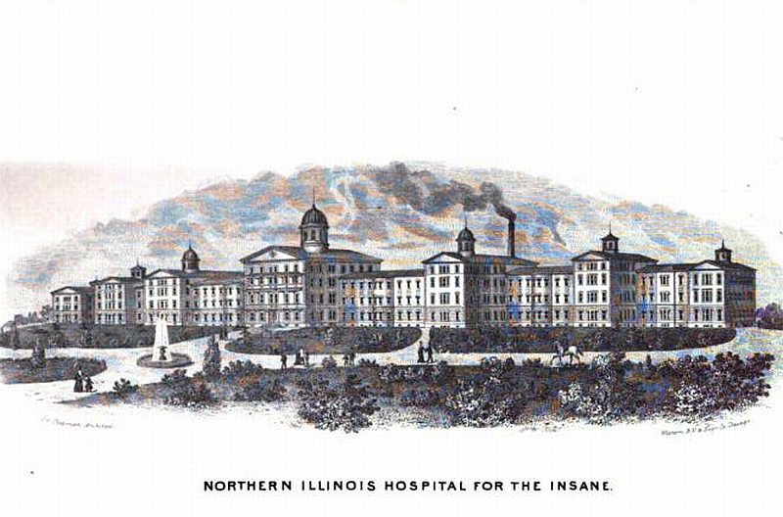
Northern Illinois Asylum for the Insane
Elgin, Illinois

Slide 24
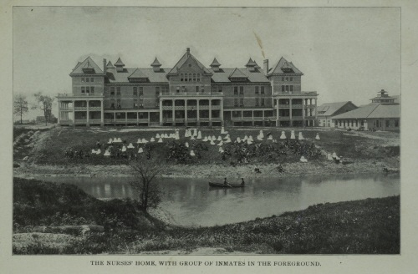
Peoria State Hospital
Bartonville, Illinois

Slide 25
The Records

Slide 26
Record types
Publicly available
Available through the courts
Obtained by “other methods”

Slide 27
Publicly found records…
Church Records
Census records for 1850, 1860, 1870 and 1880
FindAGrave
1880 DDD schedules
Newspaper reports
Personal papers of the family
Annual reports of facility
Scientific papers generated by staff

Slide 28
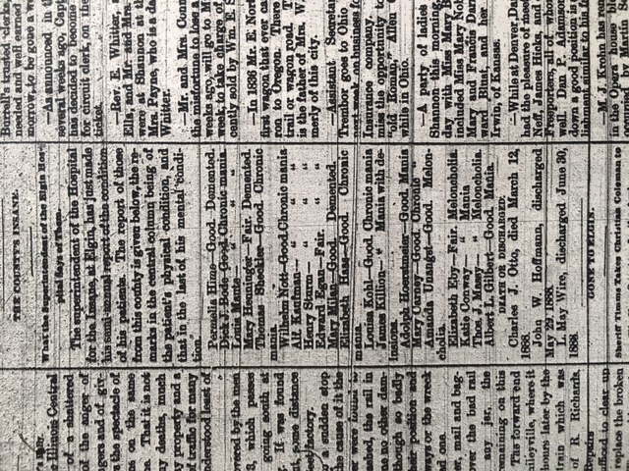
In the newspaper…
Stephenson County newspaper, 1891

Slide 29
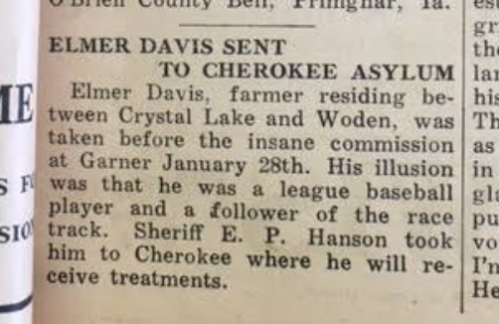
In the newspaper…
Notes:
Britt News-Tribune, 1930

Slide 30
In the newspaper…
Stephenson County newspaper, 1891

Slide 31
I expected to find these records, but didn’t…
School records
Church records
More complete newspaper collection
Death record

Slide 32
With Publicly Available Records…
Dirk | Public | Court
Born | 2 Oct 1848, Germany
Immigrated | 2 June 1854, NYC
Commitment by Court | By law
Entry into Jacksonville | Before 19 Sept 1874
Entry into Elgin | Between 1872 and 1874
Entry into Peoria | After 1902
Death | 3 July 1905
Notes:
July 3 from FAG

Slide 33
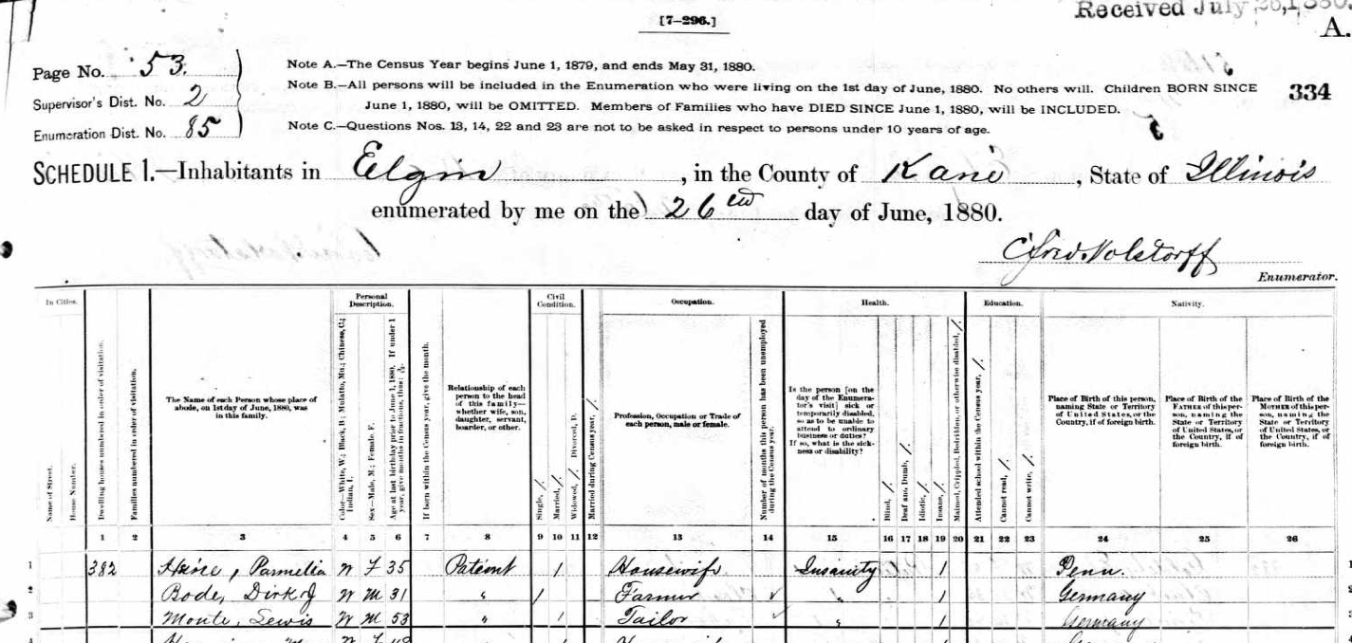
Evidence: 1880 Population Schedule
1880 U.S. Census, Kane County, Illinois, population census, Elgin, p. 53, E.D. 85, Dirk J. Bode; digital image, Ancestry.com
(http://ancestry.com : accessed 17 September 2014).

Slide 34
Evidence: 1880 Population Schedule
1880 U.S. Census, Kane County, Illinois, population census, Elgin, p. 53, E.D. 85, Dirk J. Bode; digital image, Ancestry.com
(http://ancestry.com : accessed 17 September 2014).

Slide 35

1880 Population Schedule
Type | Content
Name | Dirk J. Bode
Color/gender/age | W[hite], M[ale], 31
Relationship to HoH | patient
Marital status | single
occupation | farmer
No. months employed
Is individual… | insanity
Place of birth | Germany
Place of residence | Northern IL Asylum/Insane

Slide 36
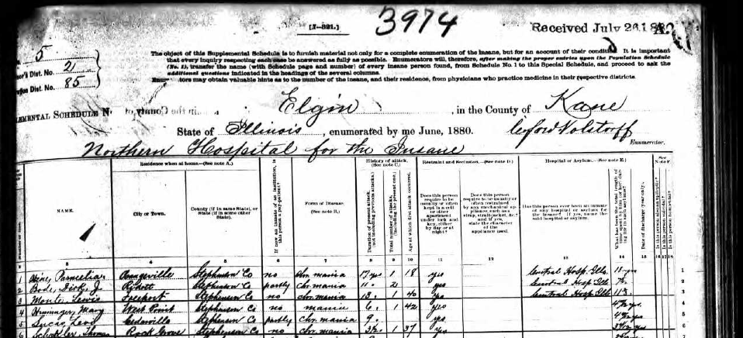
1880 DDD Schedule
1880 U.S. census, Kane County, Illinois, Dependent , Delinquent and Defective Classes schedule,
Northern Asylum for the Insane, Elgin, p. 5, line 2, Dirk J. Bode.

Slide 37
1880 DDD Schedule

Slide 38
1880 DDD Schedule
Type | Content
Name | Dirk J. Bode
Former Residence | Ridott Township, Stephenson County, Illinois
Supported by others | partly
Diagnosis | Chronic mania
No. of attacks | 2
Duration of attacks | 11 years
Previous location | Central Asylum for the Insane
Length of time in asylum | 7 - 5/12 years

Slide 39
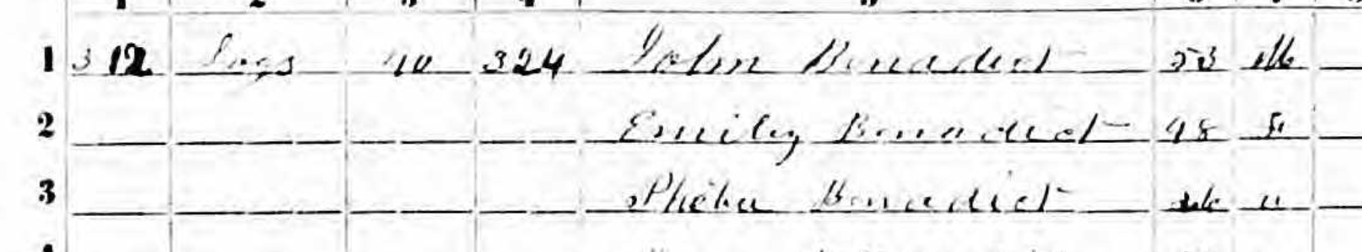
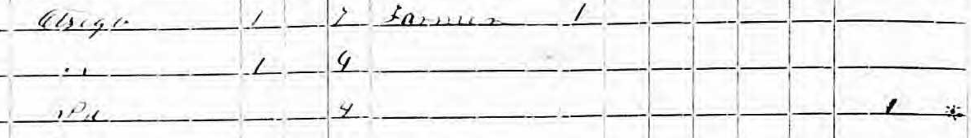
Census random thoughts
1855 NY state census, Steuben County, John Benadict.
Pheba, age 26, was deaf, blind, dumb, insane or idiot.

Slide 40
Census random thoughts
Pheba Benadict insane because of whooping cough at
age 17. Parents poor and anxious that she should be sent
to the insane asylum.

Slide 41
Record types
Publicly available
Available through the courts
Obtained by other methods

Slide 42
Thru’ Kane County Courts…
Admission record:
  Jacksonville, Elgin & Peoria
Medical Case files:
  Jacksonville, Elgin & Peoria
Annual reports
  Jacksonville, Elgin & Peoria
Transfer document: Jacksonville > Elgin
Transfer document: Elgin > Peoria

Slide 43
Obtaining Mental Health Records
Try to identify where the records are held
    State Archives
    At the asylum
    Destroyed
    If merged…
Understand the law and what the law requires
If allowed by law, make a request per the parameters
Be prepared to wait
Notes:
State of Illinois

Slide 44
What I did…
Wrote to the court (failed)
Interviewed two lawyers
Hired local lawyer
Strategized
Waited
Notes:
I have been told of two instances in the state of IL where a letter written to a particular judge released the records without a formal petition by a lawyer.

Slide 45
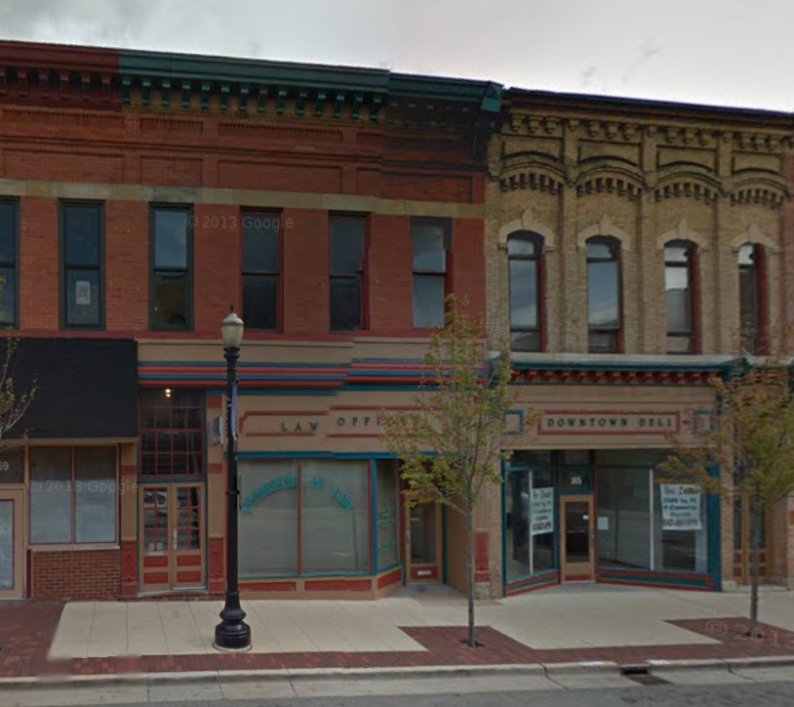
What the Lawyer did….
Strategized
  What to ask for
  Which judge to ask
  Plan A
  Plan B
Wrote the petition
Presented the petition
Waited
Negotiated for use

Slide 46
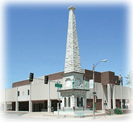
What the Judge did…
Heard the request
Granted the petition
Received and reviewed the papers
Released them to the lawyer under Plan B.

Slide 47
Thru’ Kane County Court…what I got
Admission record:
  Jacksonville, Elgin & Peoria
Medical Case files:
  Jacksonville, Elgin & Peoria
Annual reports
  Jacksonville, Elgin & Peoria
Transfer document: Jacksonville > Elgin
Transfer document: Elgin > Peoria

Slide 48
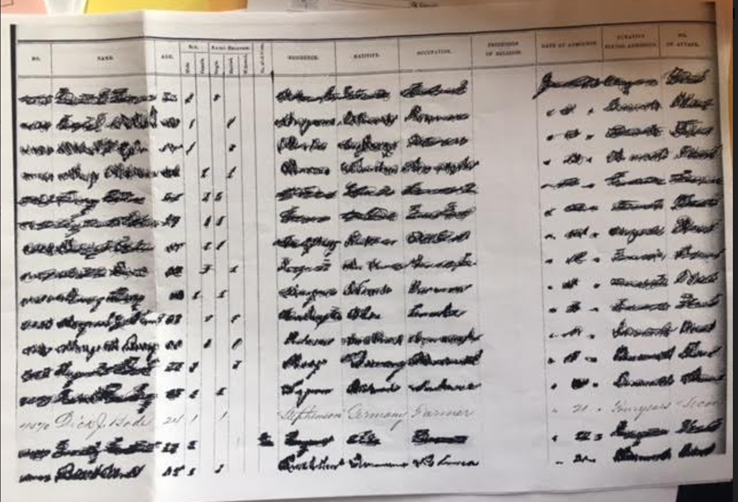
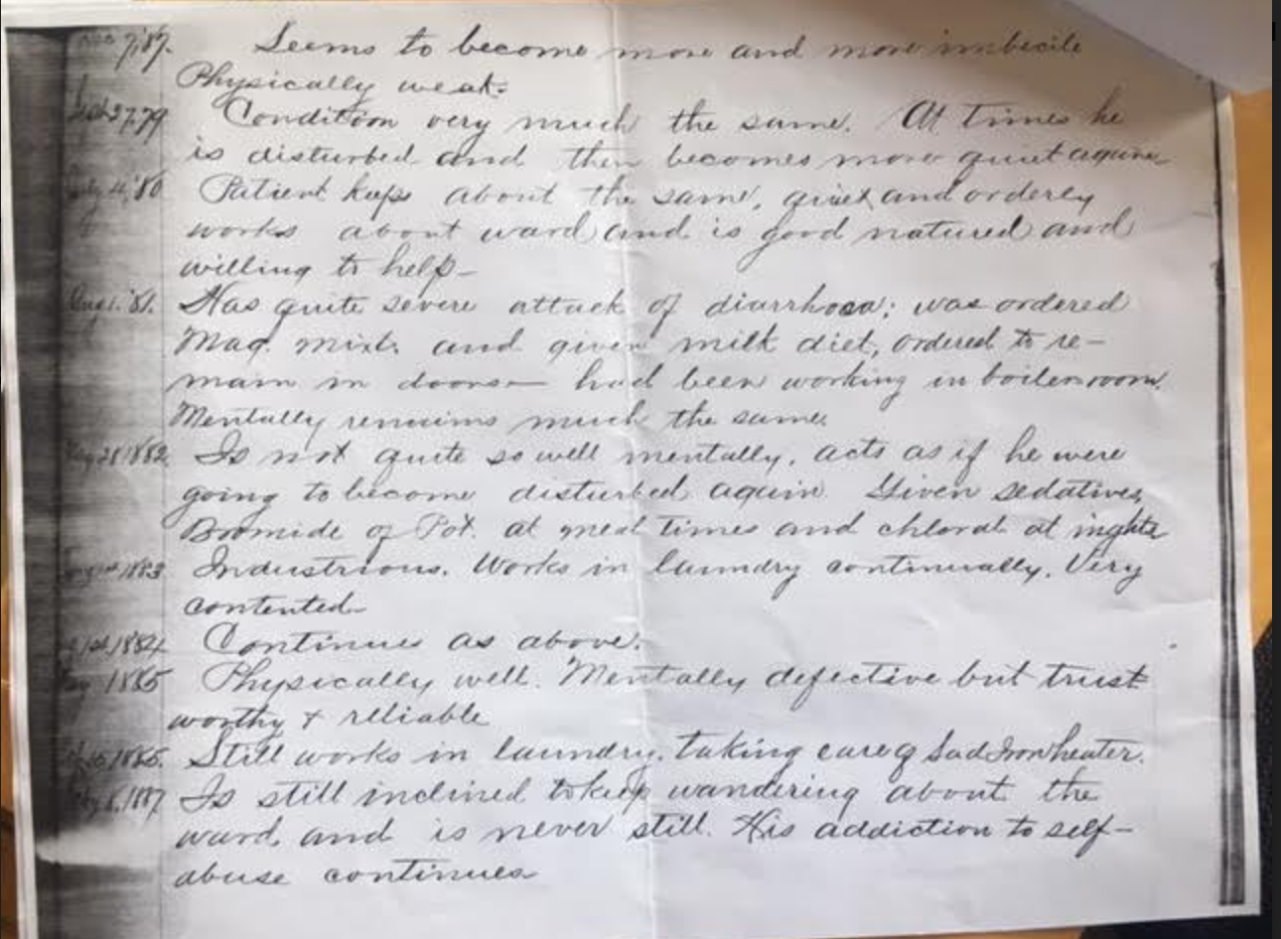

Slide 49
With Publicly Available Records…
Dirk | Public | Court
Born | 2 Oct 1848, Germany
Immigrated | 2 June 1854, NYC
Commitment by Court | Implied
Entry into Jacksonville | Before 19 Sept 1874
Entry into Elgin | Between 1872 and 1874
Entry into Peoria | After 1902
Death | 3 July 1905

Slide 50
With Court Records…
 | Public | Court
Born | 2 Oct 1848, Germany | c. 1848, Germany
Immigrated | 2 June 1854, NYC
Fight | -- | c. 1860 (12 yrs.)
1st onset | -- | 1861 (13 yrs.)
1st “cure” | -- | 1863 (15 yrs.)
2nd onset | -- | 1869 (21 yrs.)
Commitment by court | implied | implied
Entry into Jacksonville | Before 19 Sept 1874 | 21 September 1873
Entry into Elgin | After 1872 | 25 May 1875
Entry into Peoria | After 1902
Death | 3 July 1905

Slide 51
Why?
“Thinks he is the strongest man in the county-
Stuck his brother in the shoulder with a fork
– Tried to go into a house with an axe because he was not let in-”
Diagnosis:
  Public: chronic mania
  Court: Onanism. Chronic Mania

Slide 53
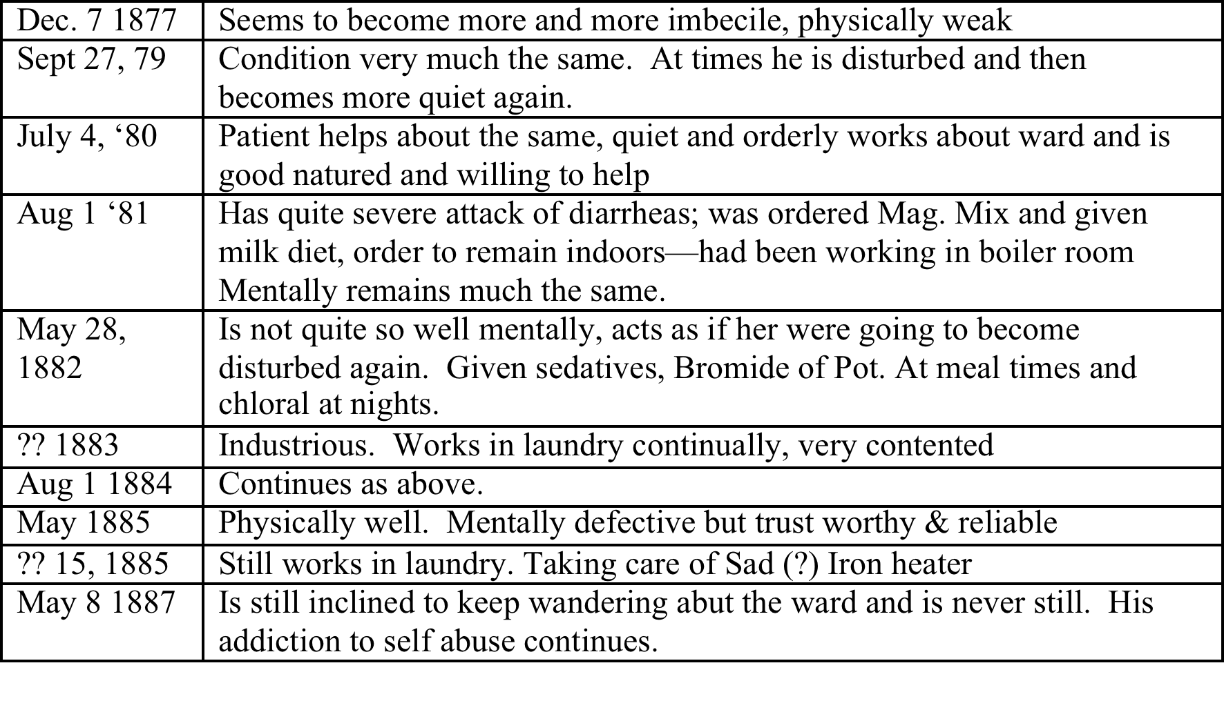
Typical entries (~annual)

Slide 54
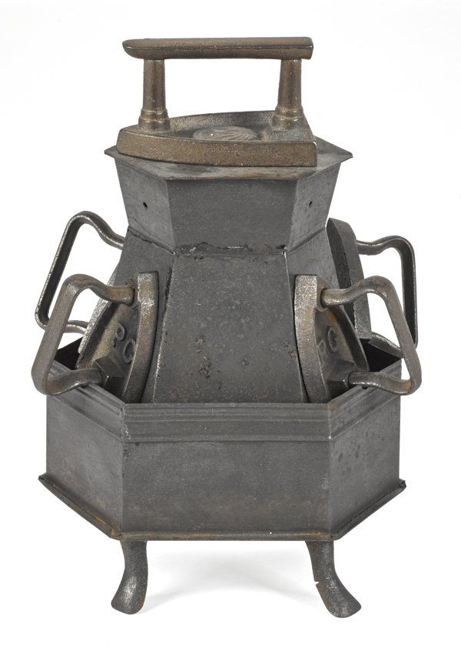
With the addition of Court records…
Cause of affliction & reaction
Official diagnosis
Symptoms
“Yearly” reports
Dates Dirk moved from one location to another
Sad Iron Heater

Slide 55
Record types
Publicly available
Available through the courts
Obtained by “other methods”

Slide 56
Records restricted
Probate Packet (restricted access)
Conservator’s Packet (restricted access)
Commitment papers (held at County Court)

Slide 57
Records restricted
Probate Packet (restricted access)
Conservator’s Packet (restricted access)
Commitment papers (held at court)

Slide 58
But, what about those “other” records?

Slide 59
With Other Records…
 | Public | Court | Other
Born | 2 Oct 1848, Germany | c. 1848, Germany
Immigrated | 2 June 1854, NYC
Fight | -- | c. 1860 (12 yrs.)
1st onset | -- | 1861 (13 yrs.)
1st “cure” | -- | 1863 (15 yrs.)
2nd onset | -- | 1869 (21 yrs.)
Commitment by court |  |  | 17 September 1873
Entry into Jacksonville | Before 19 Sept 1874 | 21 September 1873
Entry into Elgin | After 1872 | 25 May 1875
Entry into Peoria | After 1902
Death | 3 or 4 July 1905 |  | 4 July 1905
Notes:
4 July from Probate packet

Slide 60
More importantly…
One or more family members visited annually
He received a Christmas present every year
The family sent him “pin money”
Dirk had an estate valued at $6000 at the time of his death.

Slide 62
The “Dark Years”
1895-1950

Slide 63
1895 - 1950: “The Dark Years”
Backlash from Moral Treatment
Cycled back to aggressive “medical” treatment
Experimentation without consent
Instead of being welcomed into the human family, now reviled
Rise of eugenics => Nazi’s research in human engineering.
Notes:
Eugenics: well-born --were more likely to be successful= intelligent. Then can humans be engineered; lower classes should not breed. This affected the thought about immigrants: Irish, Jews,
We start seeing the rise of genealogy not just for the nobility

Slide 64
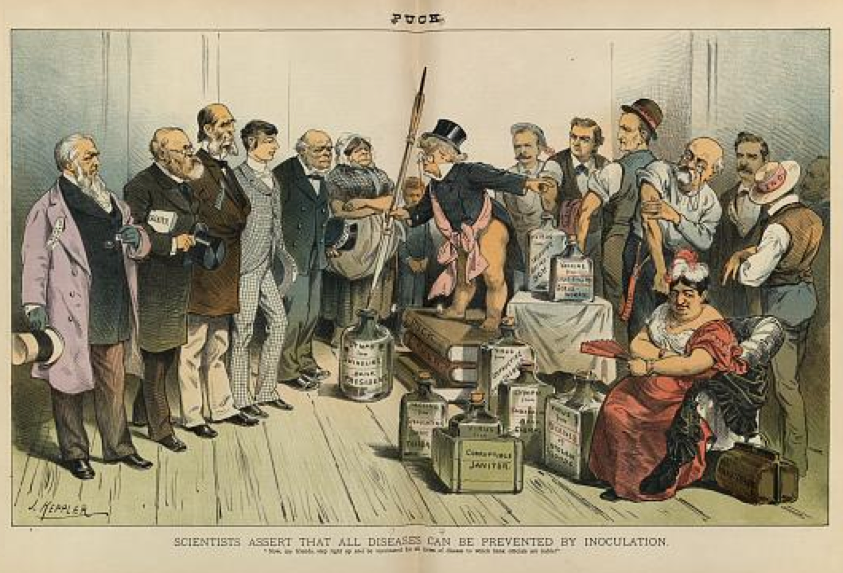
Notes:
“Scientists assert that all diseases can be prevented by inoculation”
Vaccination of something could cure everything.

Slide 65
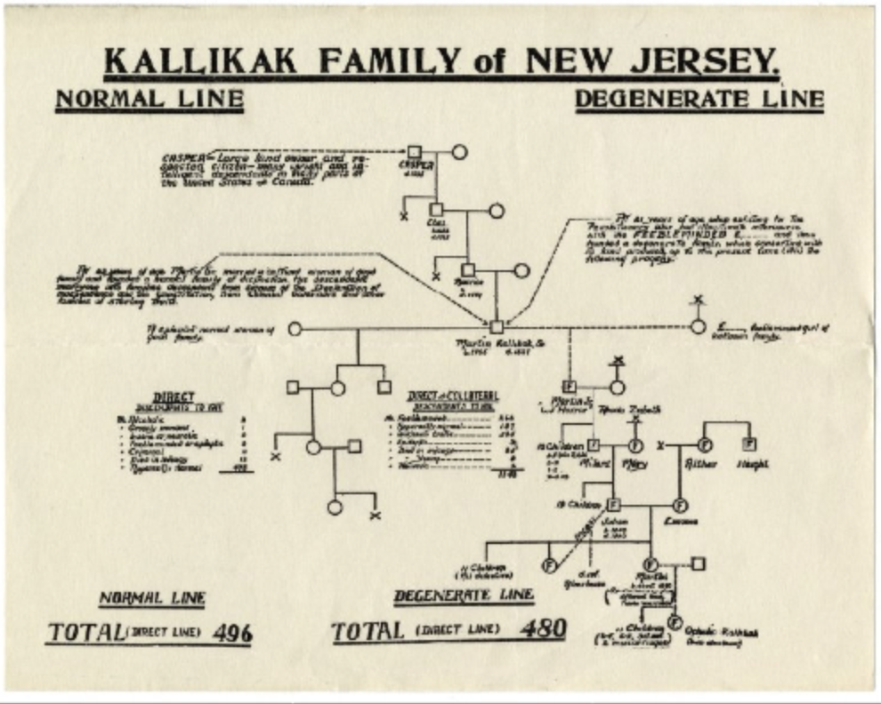
1930’s Scientific Papers
Notes:
Eugenics Record Office
Scientific papers of the 20s and 30s

Slide 66
Our goals…
Understand the genealogical problem
Understand the historical context
Learn what records are available
Notes:
HIPAA: Health

Slide 67
Resources
Bethlem Hospital (London) Records (1683-1932) can be found at http://www.findmypast.com/bethlem. This is a pay site.
Eugenics Record Office Records.http://www.amphilsoc.org/mole/view?docId=ead/Mss.Ms.Coll.77-ead.xml#abstract : accessed 15 September 2017. Index of records, some names public.
Insane Asylums: http://www.asylumprojects.org
Mental Health Record requests for some states: http://www.asylumprojects.org/index.php?title=Asylum_Projects_Genealogical_Requests

Slide 68
Lee, Kate. A Year at the Elgin Insane Asylum, 1902. Google Books.
Packard, Elizabeth, The Prisoners' Hidden Life Or Insane Asylums Unveiled (1868) Kessinger Publishing, LLC, February 21, 2008.
Available on Google books.
Pouba, Katherine & Ashley Tianen. “Lunacy in the 19th Century: Women’s Admission to Asylums in the United States of America.” Oshkosh Scholar. 1(April 2006): 95-103.
Skloot, Rebecca. The Immortal Life of Henrietta Lacks. New York: Broadway Books, 2011. The rise of compliance law; a great read.

Slide 69
Notes:
#1435

Slide 70
Finding Dirk
http://asylumproject.org
Insanity in the 19th Century
Minnesota Genealogical Society
3 March 2021

Slide 71
Questions?
Jill Morelli, cg®
http://theCDGseries.wordpress.com
Minnesota Genealogical Society
3 March 2021

Slide 72
Questions?
Jill Morelli
http://genealogycertification.wordpress.com
Colorado Genealogical Society
16 September 2017

